Slide 1



E-commerce_fixed (1) (1)
View in Power BI
Last data refresh:
5/7/2026 5:46:50 PM UTC
Downloaded at:
5/7/2026 5:52:29 PM UTC

Slide 2
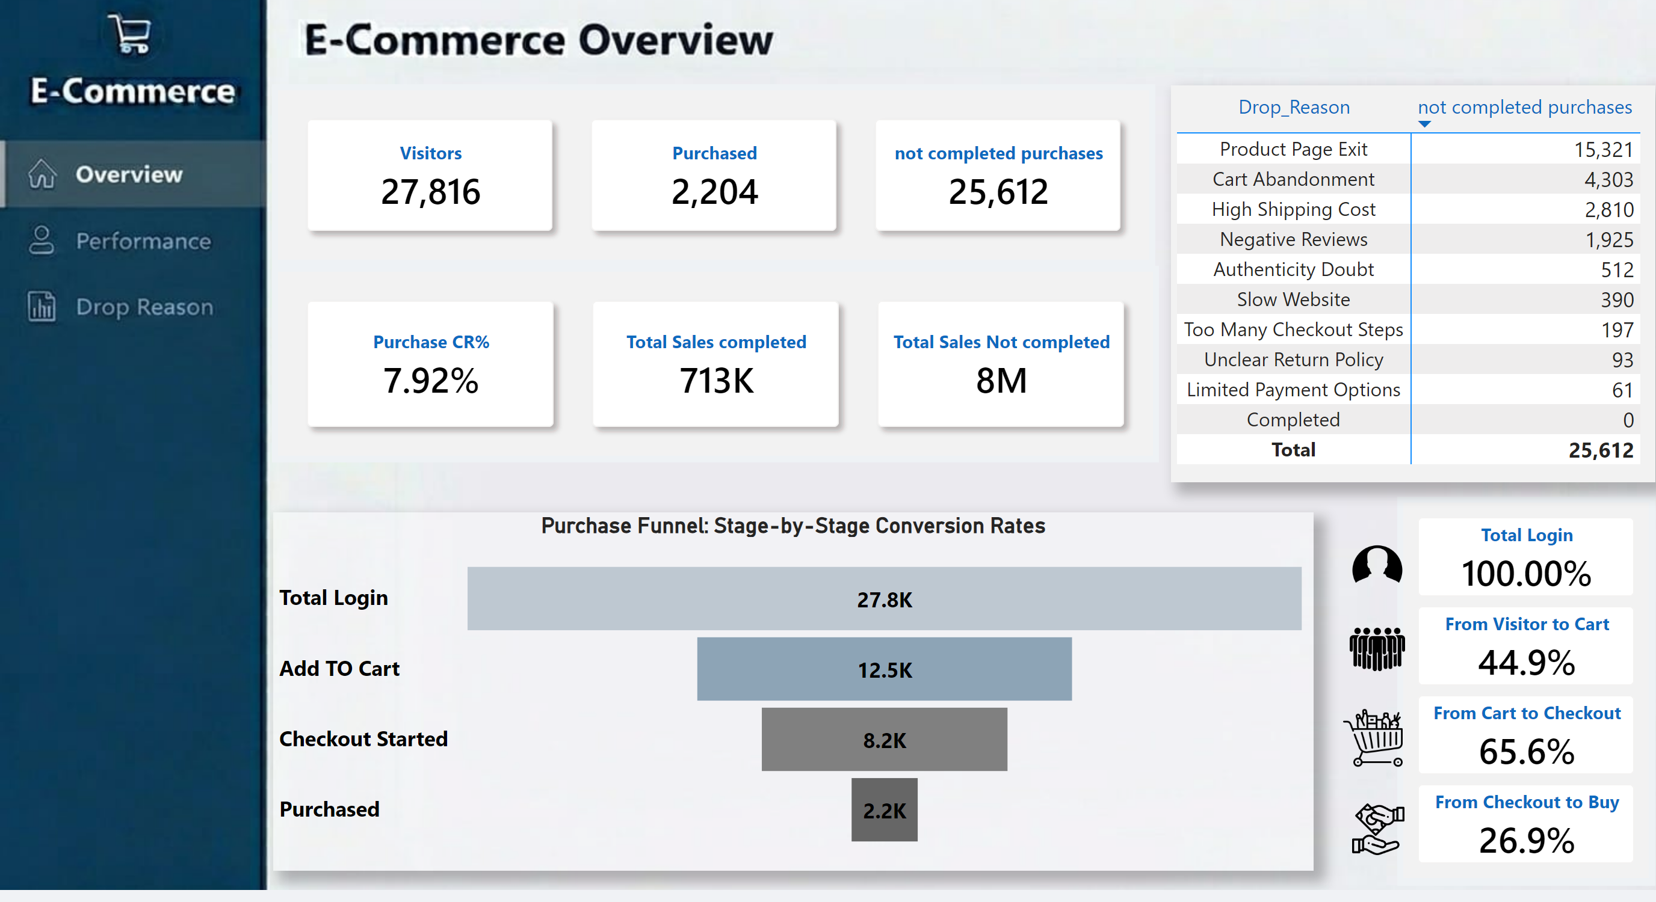
Overview
Notes:
actionButton
No alt text provided
actionButton
No alt text provided
pivotTable
No alt text provided
image
No alt text provided
cardVisual
No alt text provided
cardVisual
No alt text provided
Purchase Funnel: Stage-by-Stage Conversion Rates
No alt text provided
iiiiiiiiii
No alt text provided
image
No alt text provided
image
No alt text provided
image
No alt text provided

Slide 3
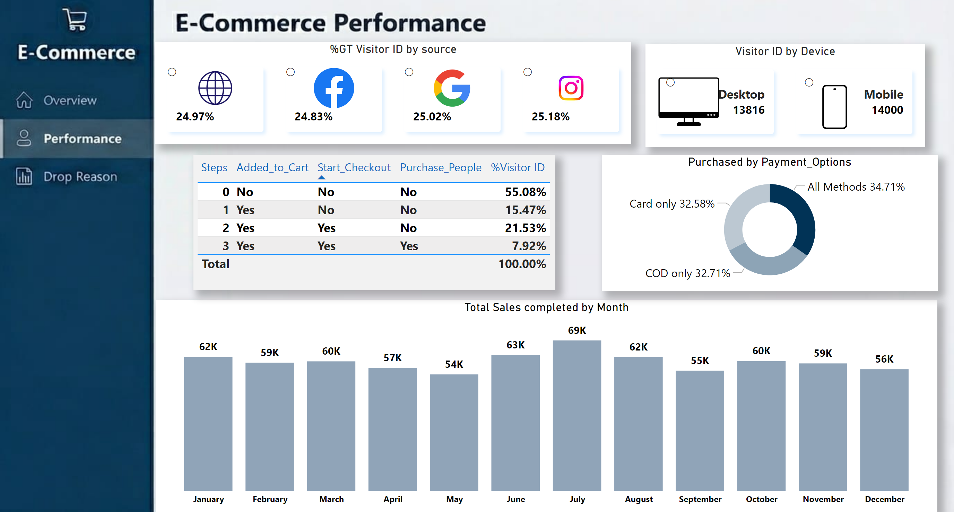
Preformance
Notes:
clusteredColumnChart
No alt text provided
donutChart
No alt text provided
actionButton
No alt text provided
actionButton
No alt text provided
tableEx
No alt text provided
advancedSlicerVisual
No alt text provided
advancedSlicerVisual
No alt text provided
image
No alt text provided
image
No alt text provided

Slide 4
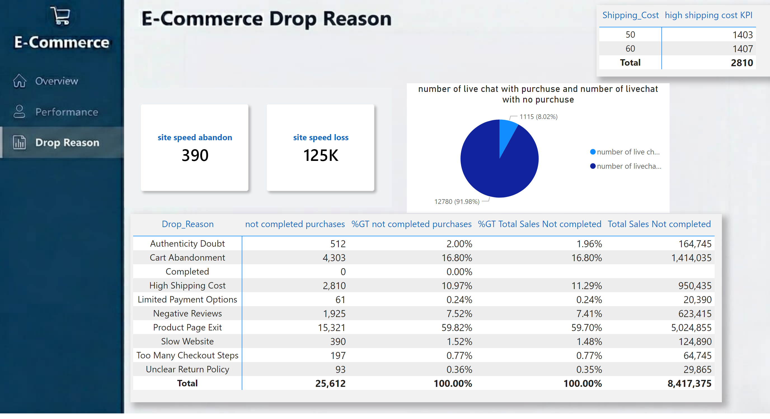
Drop Reason
Notes:
cardVisual
No alt text provided
pivotTable
No alt text provided
pieChart
No alt text provided
pivotTable
No alt text provided
actionButton
No alt text provided
actionButton
No alt text provided

